Slide 1
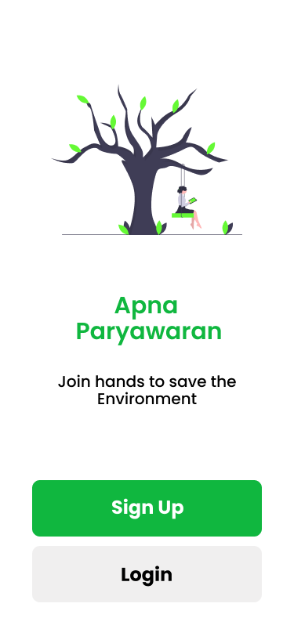
Hack Fusion Mid-Evaluation Presentation :
Features Implemented Till Last Commit :
Firebase Authentication
Manually - Email / Password
3rd Party Integration - Google OAuth
User Role Management
Auto Assignment - Basic Role (Level 1 assigned on new account creation)
Request for upgrade (Level 2 for NGO, Level 3 for Higher Authorities)
Firebase Functions Implementation
Trending Post Section (Judgement based on Upvotes on recent posts / High Engagement)
Add Post section completed.
Registered users can add their posts/issues.
User Profile Section completed
User can also register request for level upgradation.
UI for other 4 Sections (Home, Add Post, NGO contact,Stats)

Slide 2


Features to be Implemented :
Home Page Functionality (Fetch nearby located posts)
Statistics Charts Addition
Chat Feature
NGO Authorised User Functionalities
Higher Authority Functionality
Section of NGO request for approval
Verification of issues solved by NGO
We have utilised our full time from 18th June to 20th June in overall planning and preparing the pipeline for our proposed application and we are exactly working on the same. We will try to include all the functionalities as proposed in the submitted document.

